Slide 1
An Efﬁcient Abortable-locking Protocol for Multi-level NUMA Systems
ppopp 17
Milind Chabbi
Hewlett Packard Labs milind.chabbi@hpe.com
Abdelhalim Amer
Argonne National Laboratory aamer@anl.gov
Shasha Wen, Xu Liu
College of William and Mary {swen, xl10}@cs.wm.edu

Slide 2
Background
NUMA System
MCS Lock
HMCS Lock (Hierarchical MCS Lock)

Slide 3
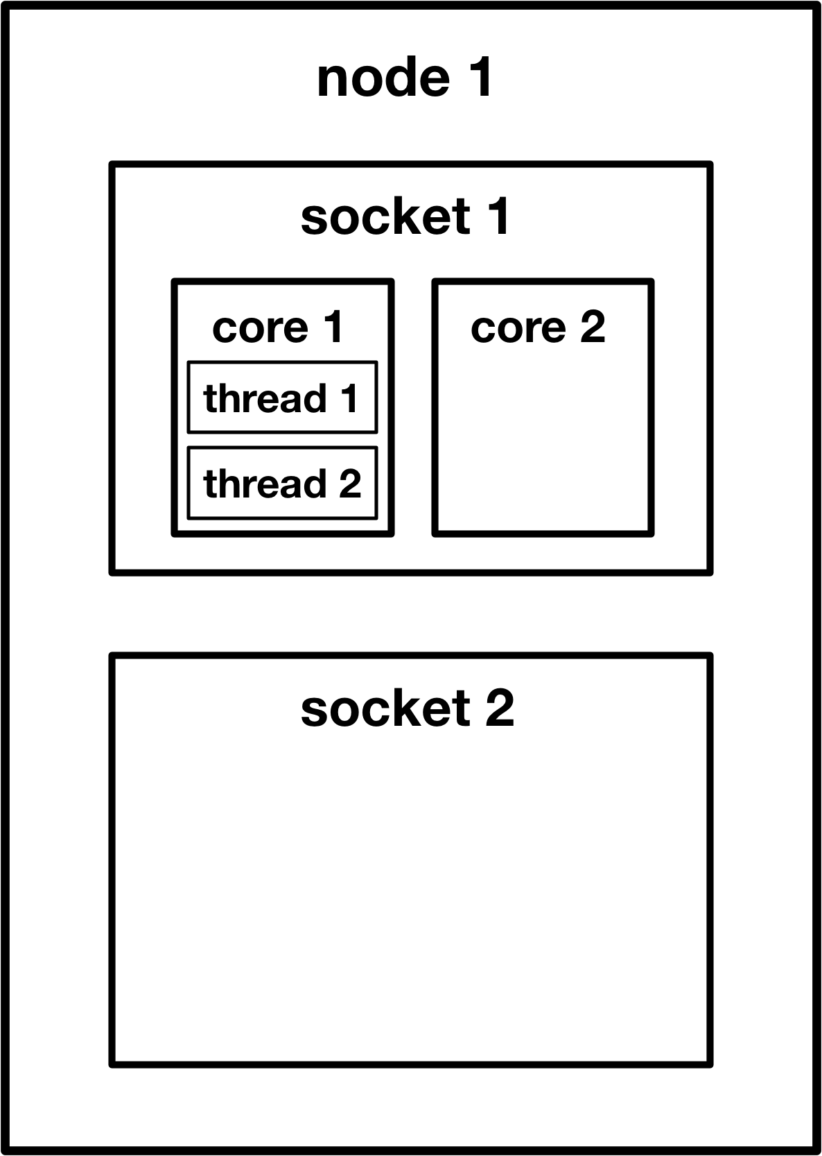
NUMA System
Non Uniform Memory Architecture is a computer memory design used in multiprocessing.
The memory access time depends on the memory location relative to the processor.
Local memory faster than non-local.

Slide 4
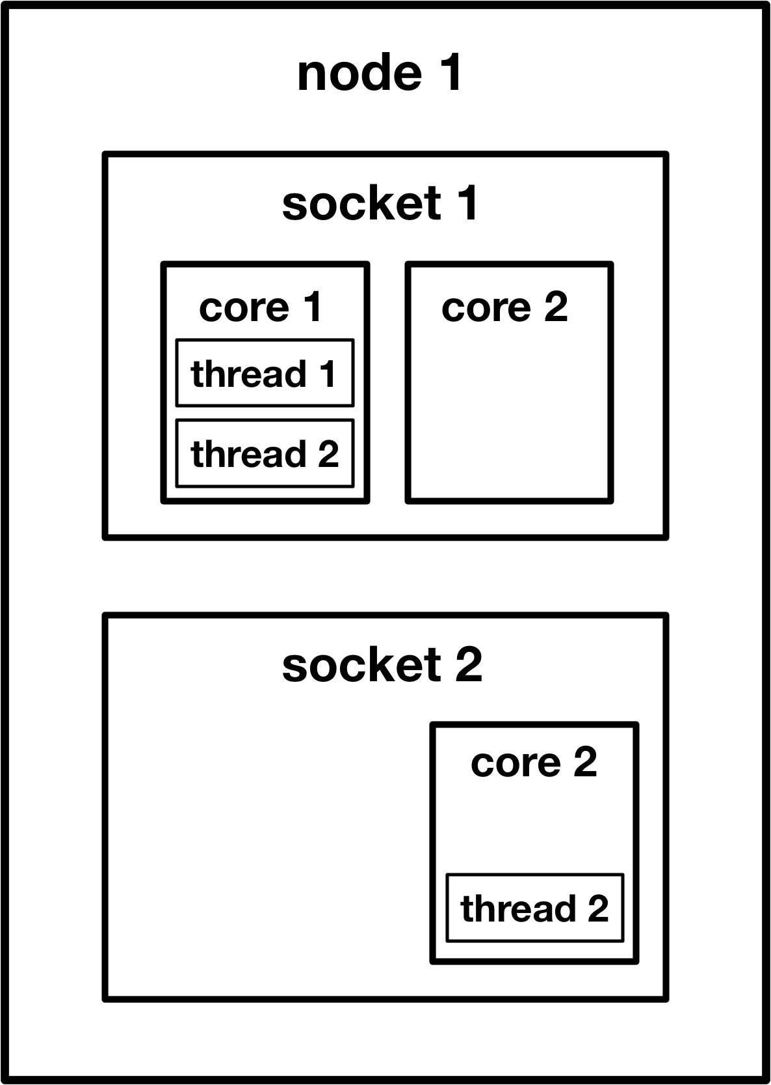

MCS Lock
Guarantees FIFO ordering of lock acquisitions.
Spin lock on local-accessible flag variable.
Drawback: passing lock between different NUMA node is slow.

Slide 5
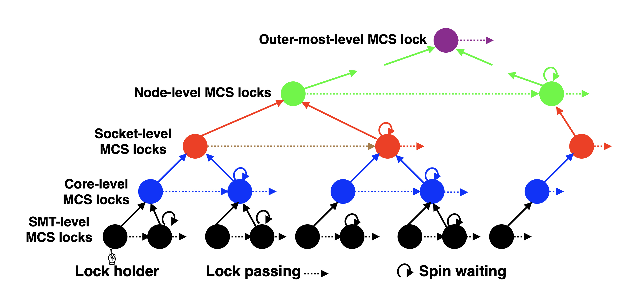


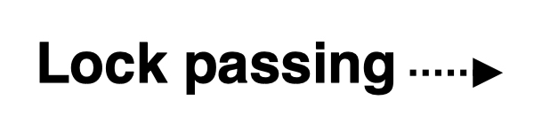

HMCS Lock (Hierarchy MCS)
Hierarchy MCS Lock.
Trade fairness for higher throughput.
node
socket
core
thread

Slide 6
Drawback of HMCS Lock
Because HMCS doesn’t guarantee a global FIFO ordering of lock acquisition. Sometimes lock acquisition can incur long latency.
Such a long latency may be intolerable for certain kind of application.
Solution: Abortable Lock

Slide 7
Main Design
MCS-T: Abortable MCS lock.
HMCS-T: Abortable HMCS lock.
(Equivalent to n level MCS-T)

Slide 8
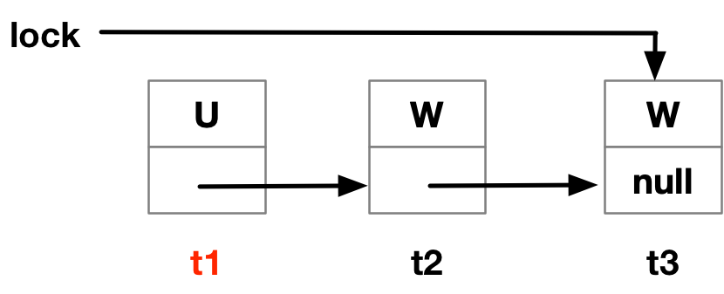
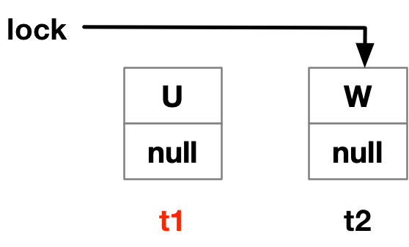
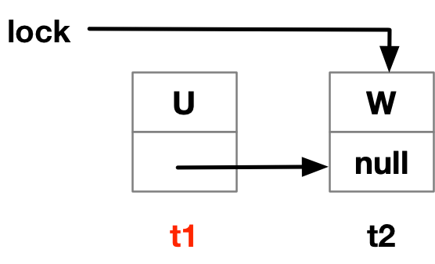
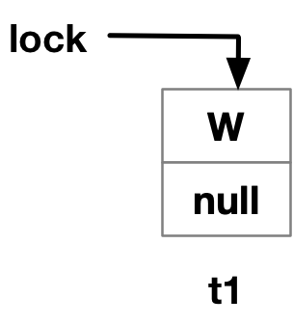
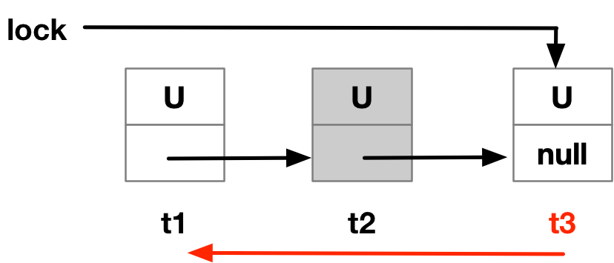
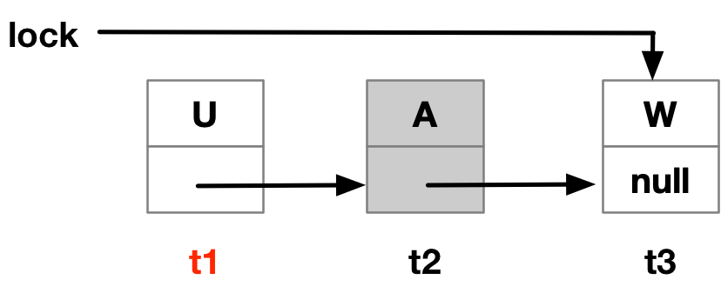
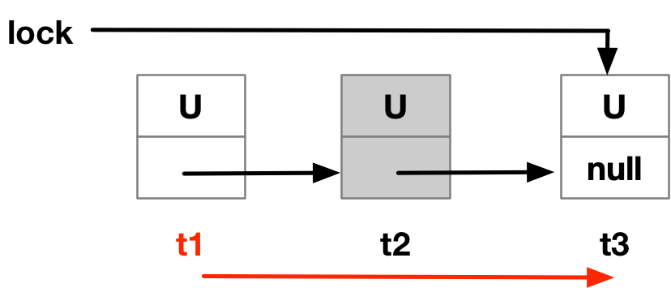
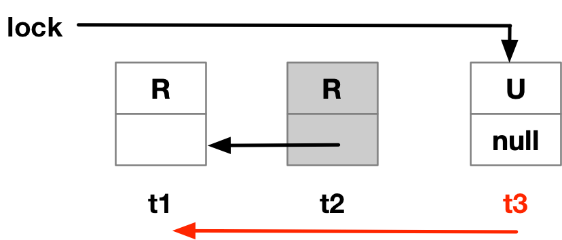
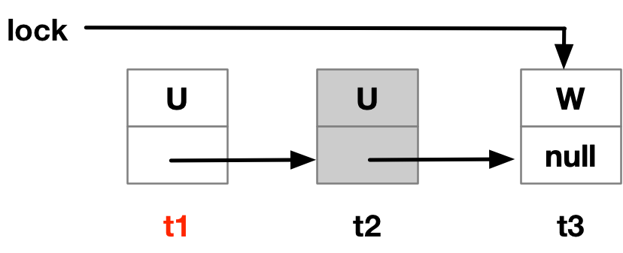
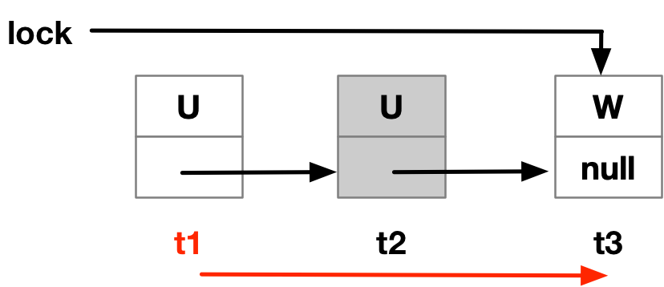

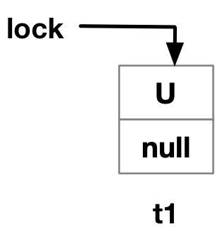
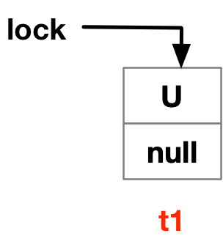
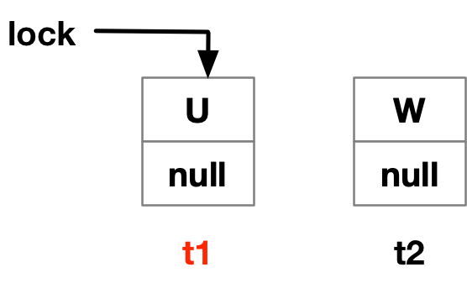

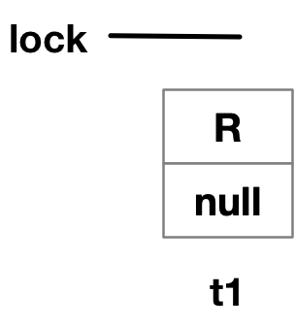
MCS-T (Time out)
Example:

Slide 9
MCS-T Acquire Lock
Swap the status field to W.
Possibility of previous flag:
R: simply follow MCS lock enqueue protocol.
A: re-acquire a lock that had abandoned.
U: wait to be recycled.

Slide 10
MCS-T Release Lock
Swap successor’s status field to U.
Possibility of previous flag:
W: simply follow the MCS protocol.
A: pass lock to first non-abandon thread.

Slide 11
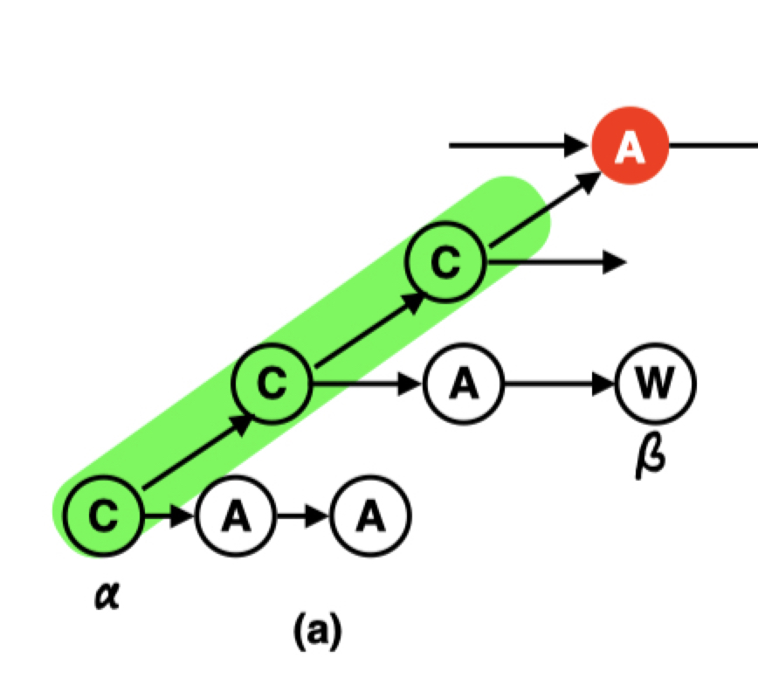

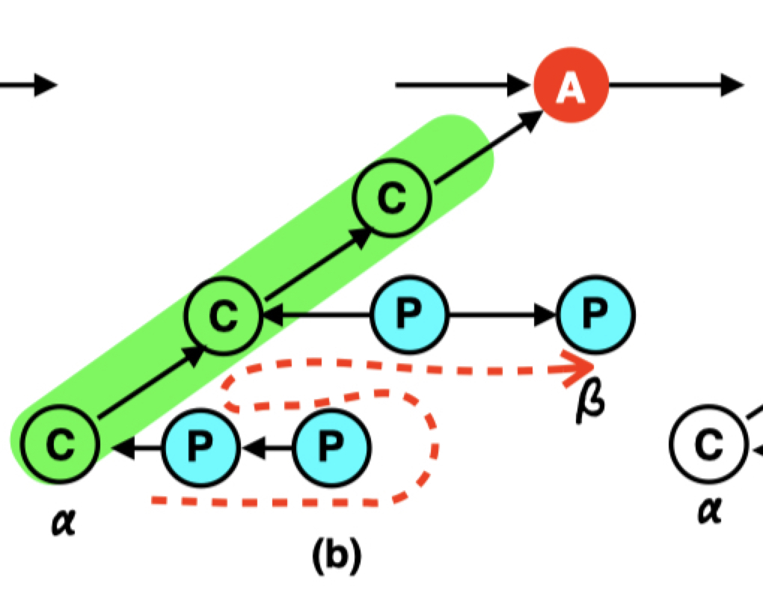
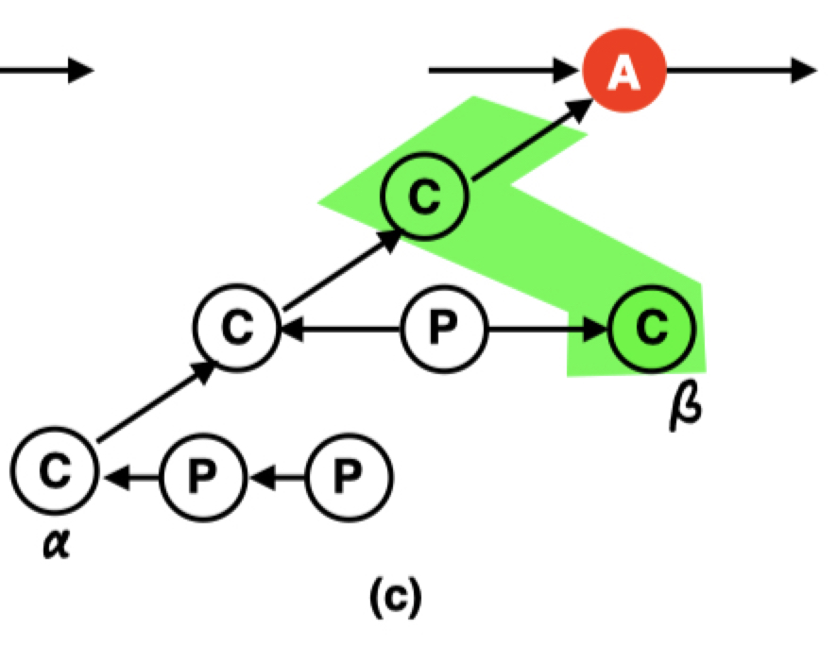
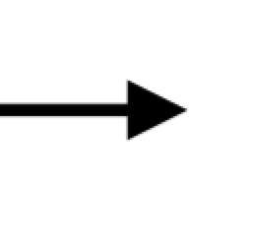
HMCS-T (Time out)
C: succeed to get lock of current level.
P: Inherit a prefix of locks.
Node
Socket
Core
Thread

Slide 12
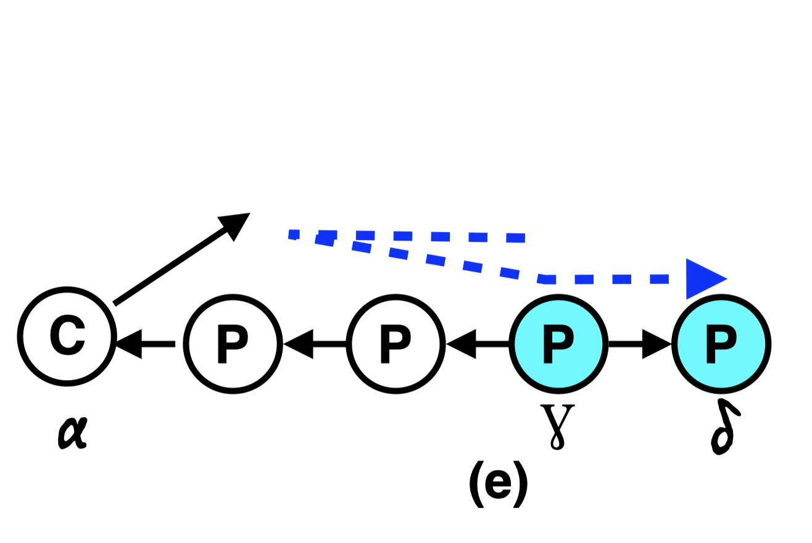
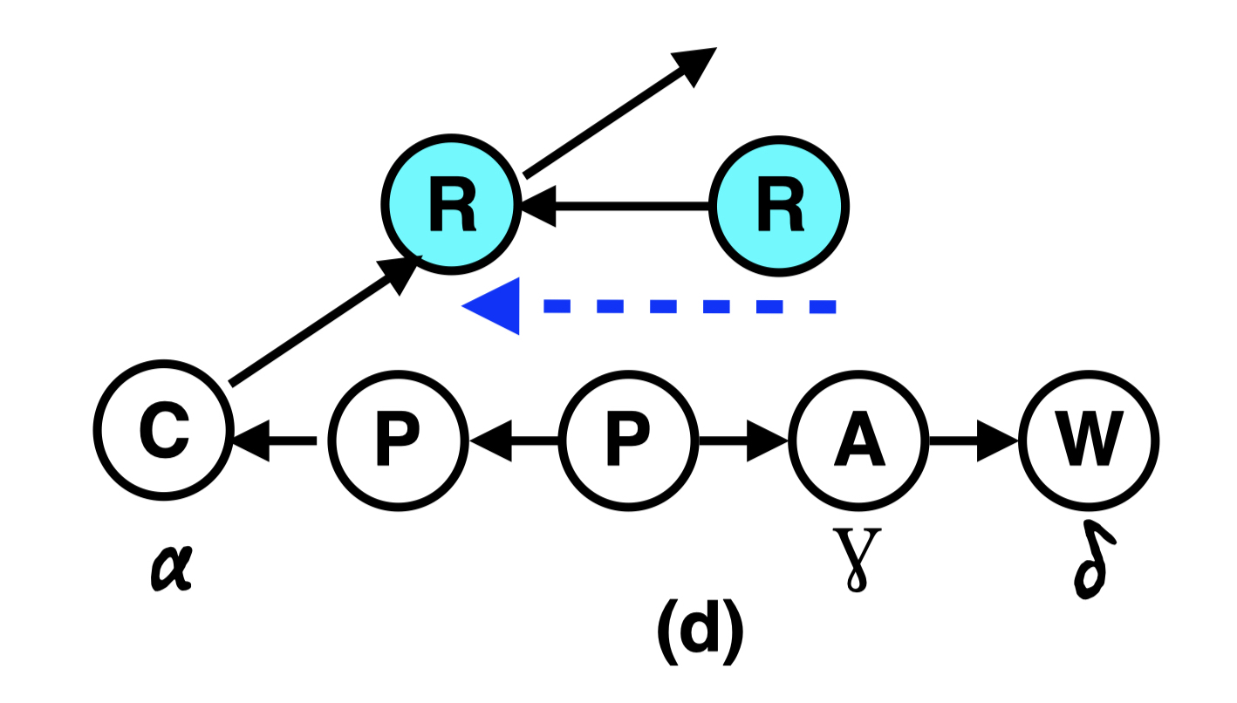
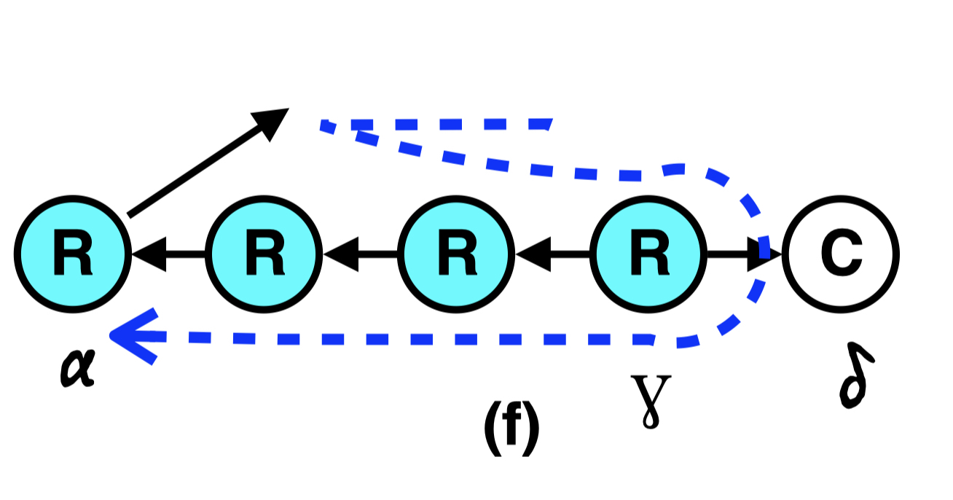
HMCS-T (Time out)
C: succeed to get lock of current level.
P: Inherit a prefix of locks.

Slide 13








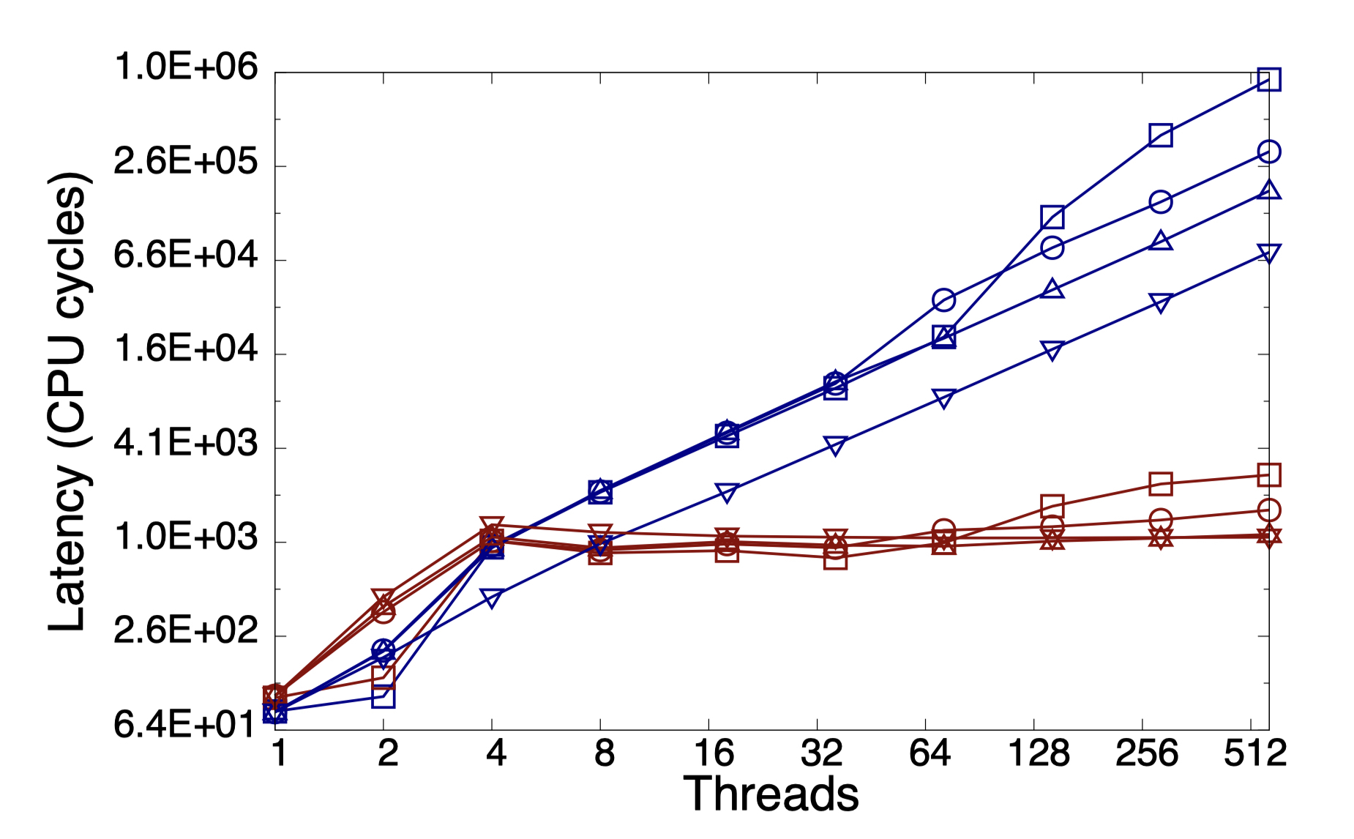
Evaluation
Latency

Slide 14
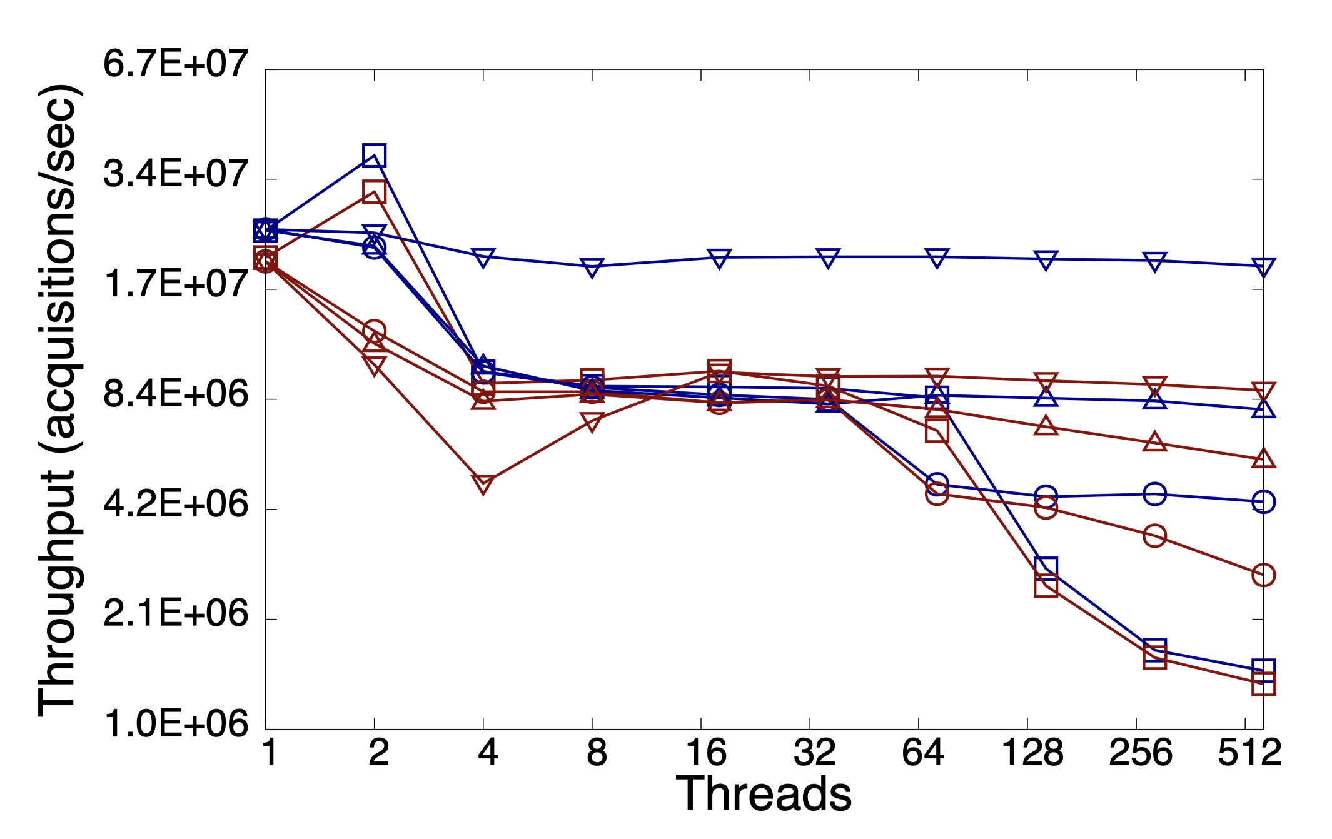
Evaluation
Throughput

Slide 15

Q & A

